Slide 1
Machine Learning Prediction of Severe Car Crashes
Steve Schneider
Data Scientist
SQLinsight.net

Slide 2
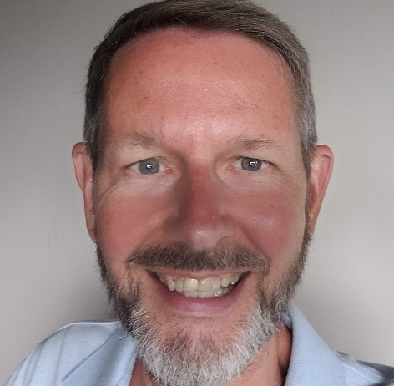
Steve
Schneider
About Me
Data Scientist
MCSE (since 1999!!!) & MCDBA
Speaker at Tech Ed on Analysis Services
Speaker at SQL Saturdays & more…
Current focus: Machine Learning, Azure
I love to sail…a Corsair 24’ Sprint 750 Trimaran
Blog at: www.SQLInsight.net/blog
SQLinsight
https://github.com/steveSchneider2/Pass
linkedin.com/in/steveschneider1
SteveS@SQLinsight.net

Slide 3
Environment/Context
2+ million records of auto crashes in Florida during 2014 and 2015 in SQL server
Development : Anaconda/Spyder/Python (3.8.8)
Front-end: streamlit.io

Slide 4
The plan…
Session Objectives
The app… & Walk-thru how it works
Visuals … (the meat of the session)

Slide 5
Session Objectives
Demonstrate a simple machine learning app
Walk thru the visuals I used to develop the ML model
Give you ideas that you can implement
Discuss what’s on Github

Slide 6
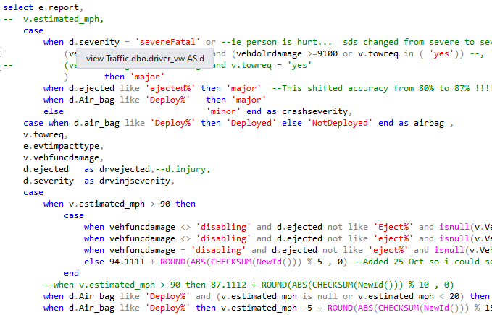
NOT session objectives
Not teaching you python
Not teaching Machine learning
Not teaching Feature engineering

Slide 7
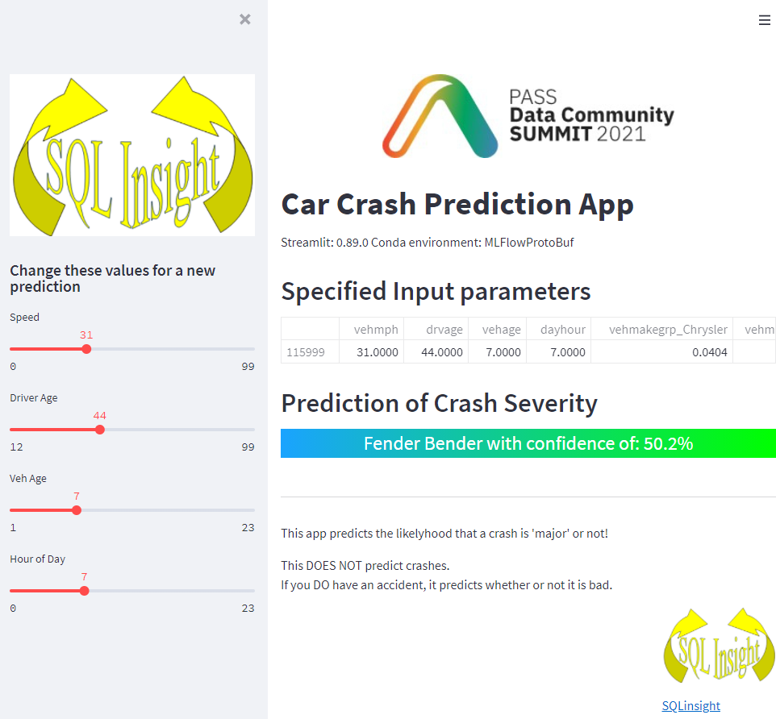
The app…

Slide 8
Let’s see the app!

Slide 9
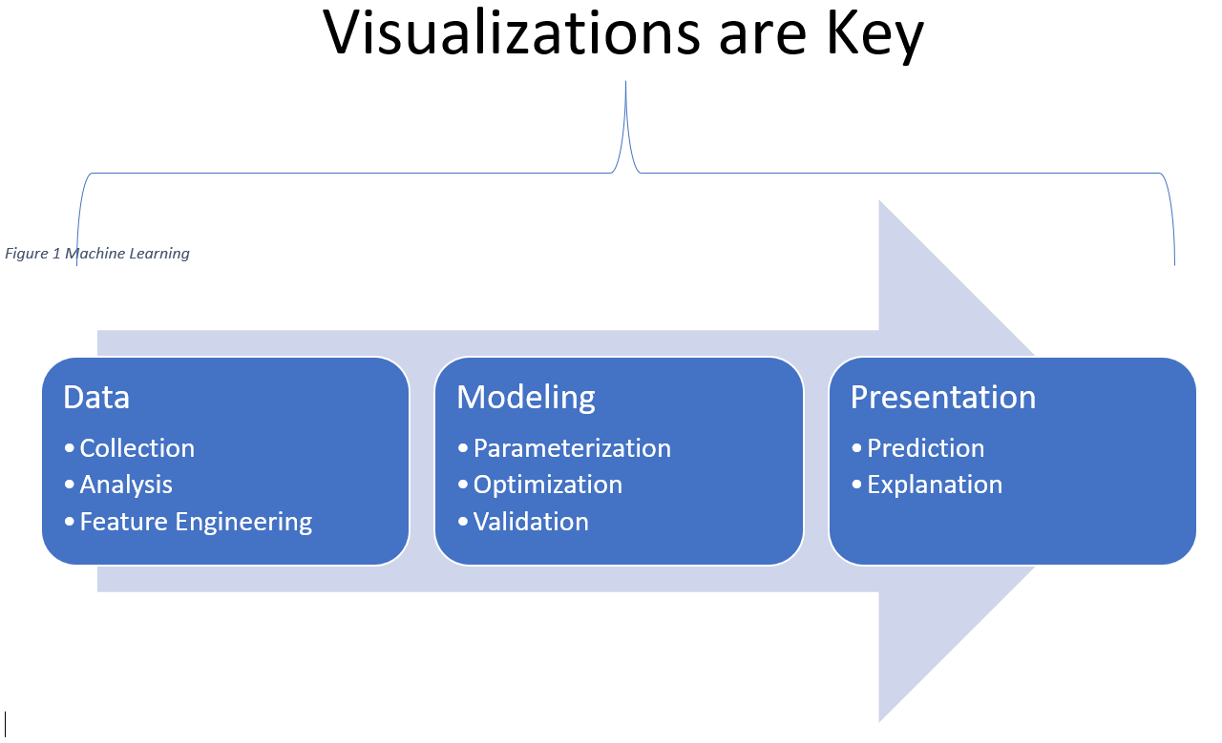

Slide 10
Visuals Groups
Exporatory Data Analysis --3
Exploring Model Performance --3
Explaining the Model --2

Slide 11
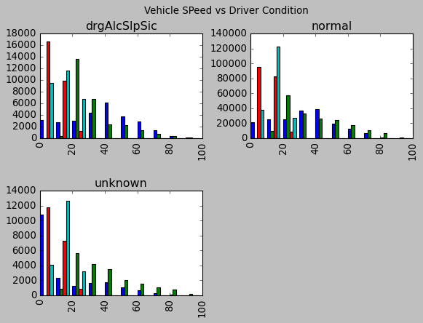
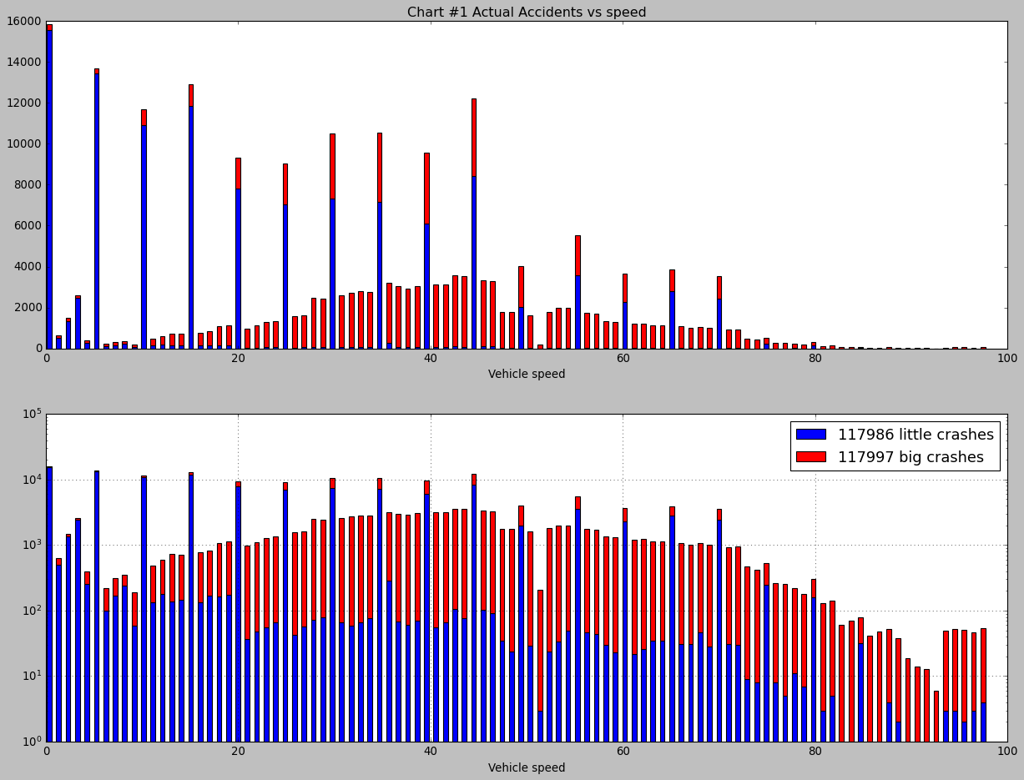
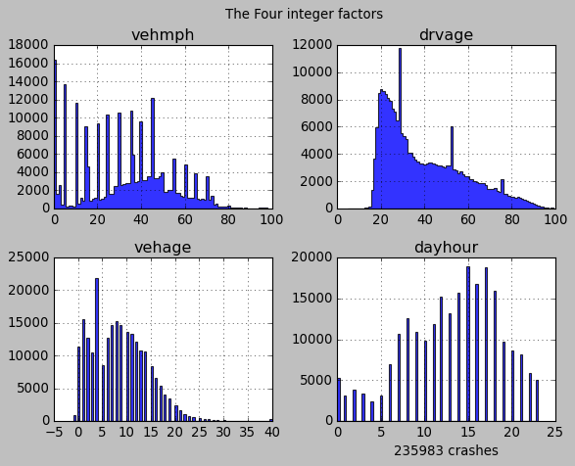
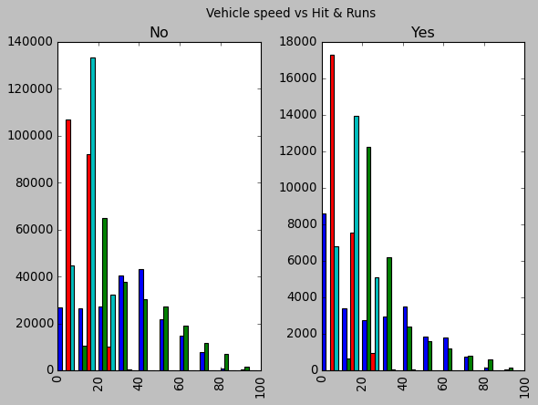
Exploratory Data Analysis (EDA)

Slide 12
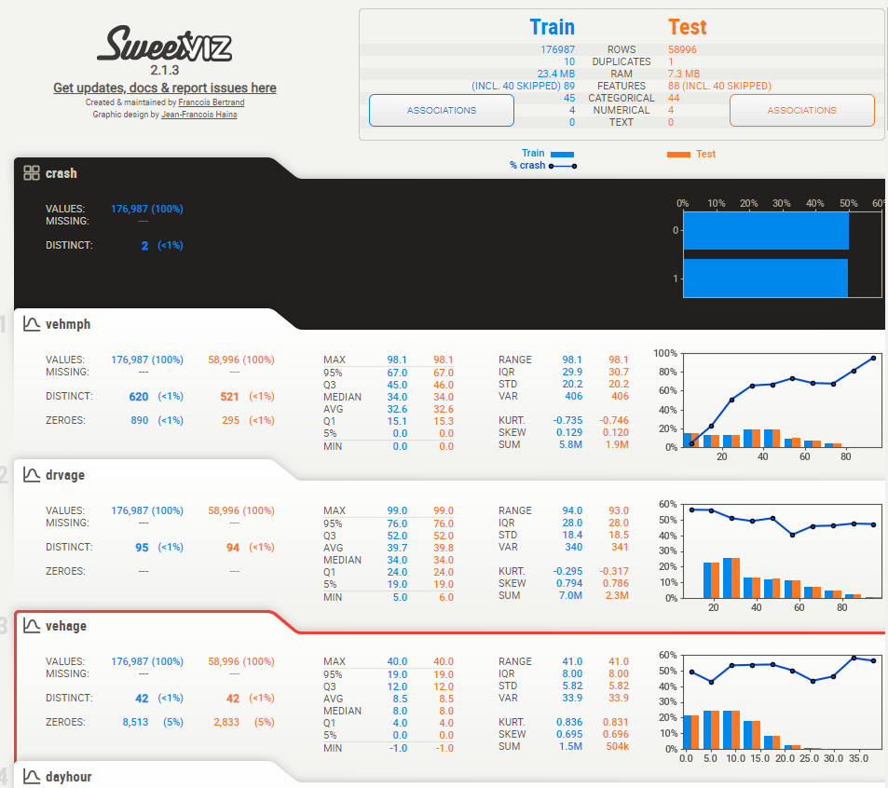
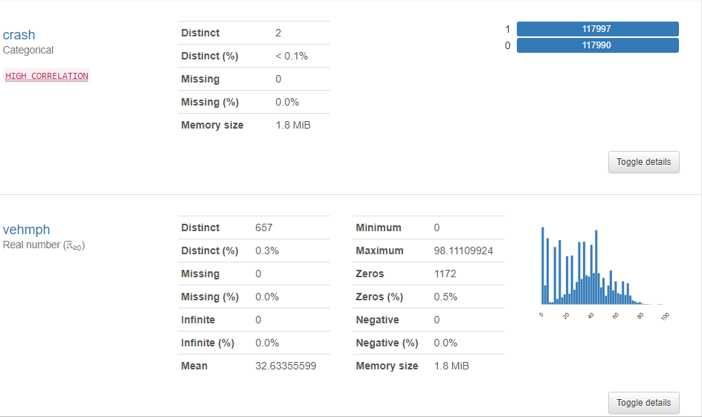
Exploratory Data Analysis v2 (EDA)
Pandas Profiler

Slide 13
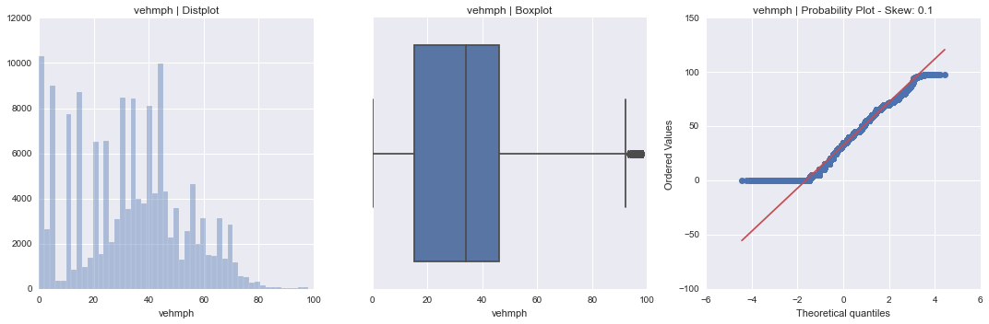
Exploratory Data Analysis v3 (EDA)
AutoViz()

Slide 14
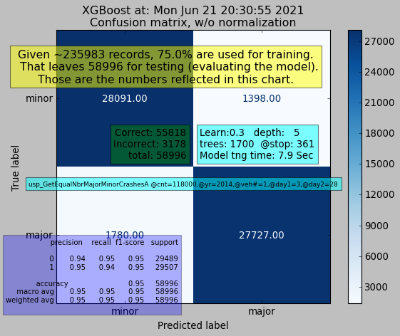
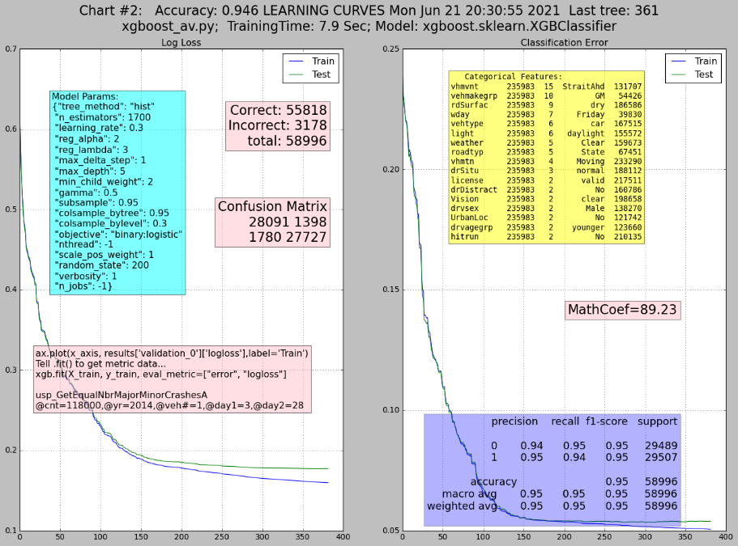
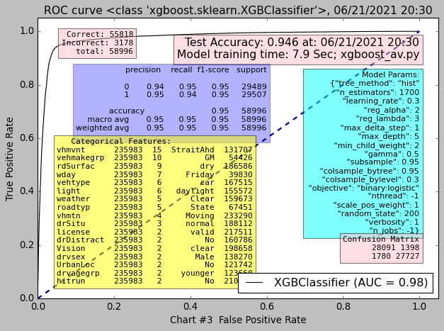
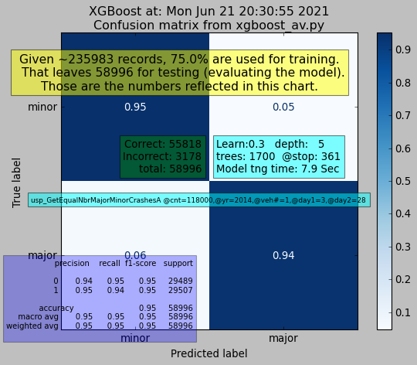
Exploring Model Performance (EMP)

Slide 15
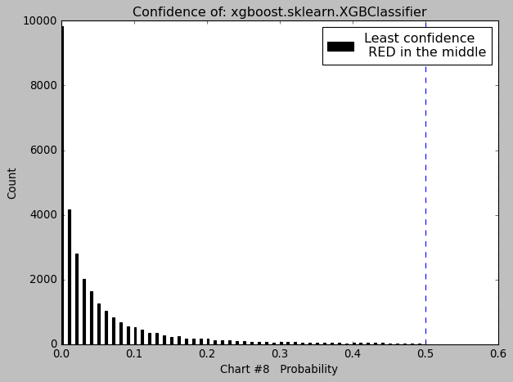
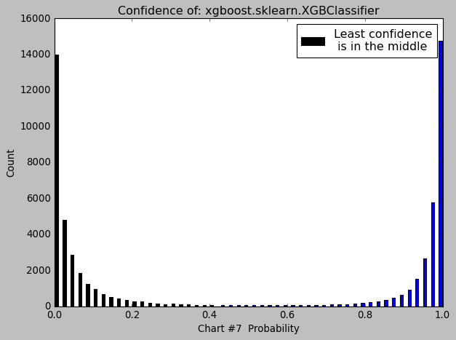
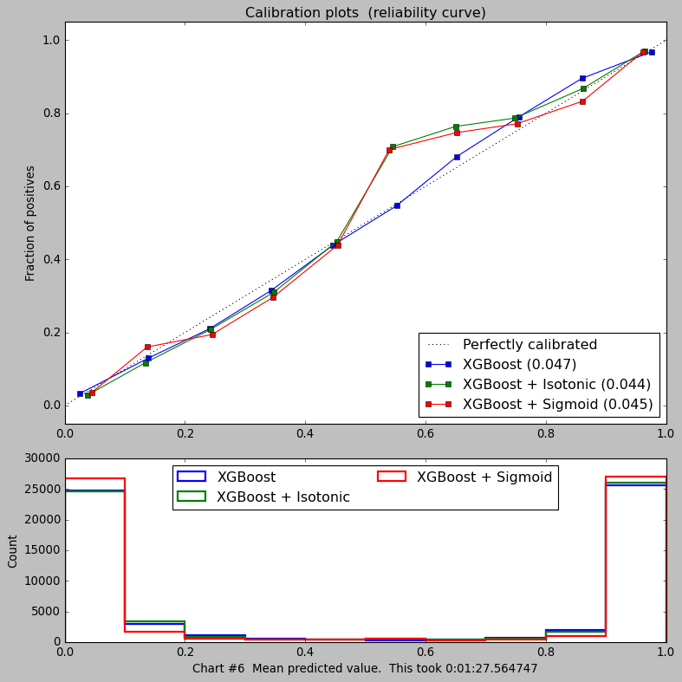
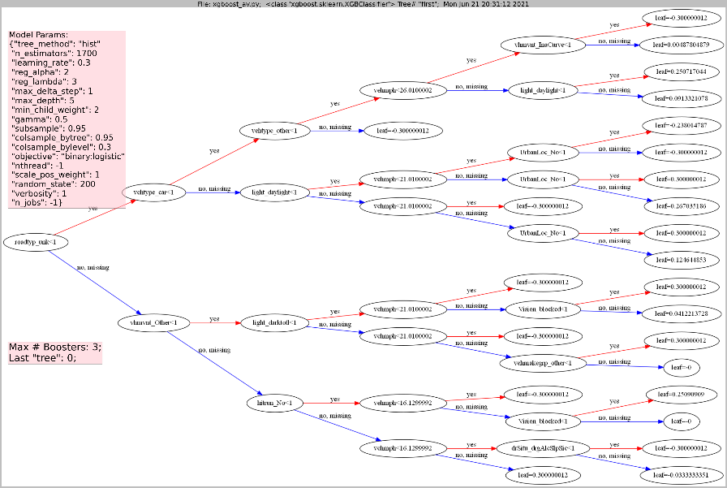
Exploring Model Performance v2 (EMP)

Slide 16
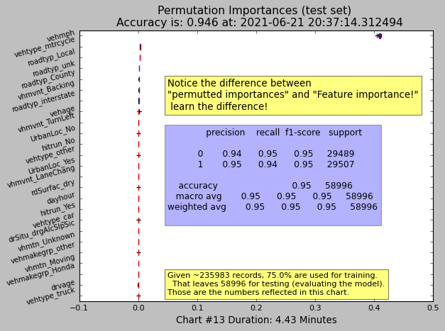
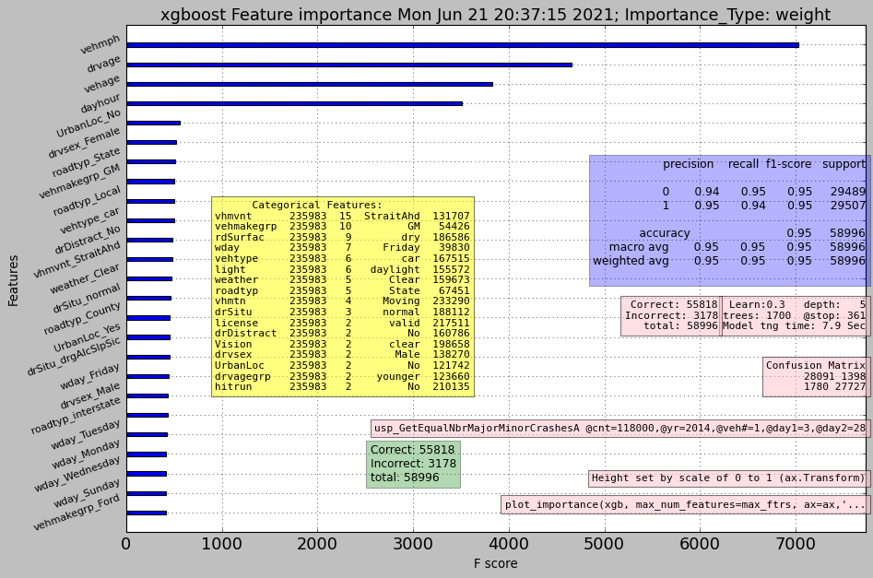
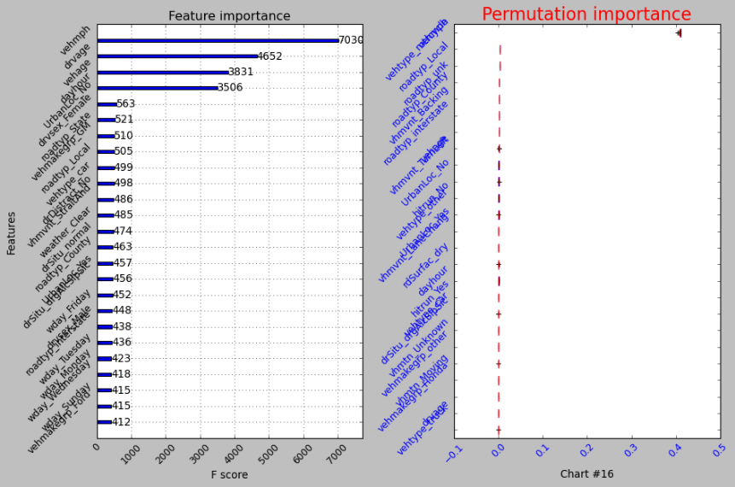

Explaining the Model

Slide 17
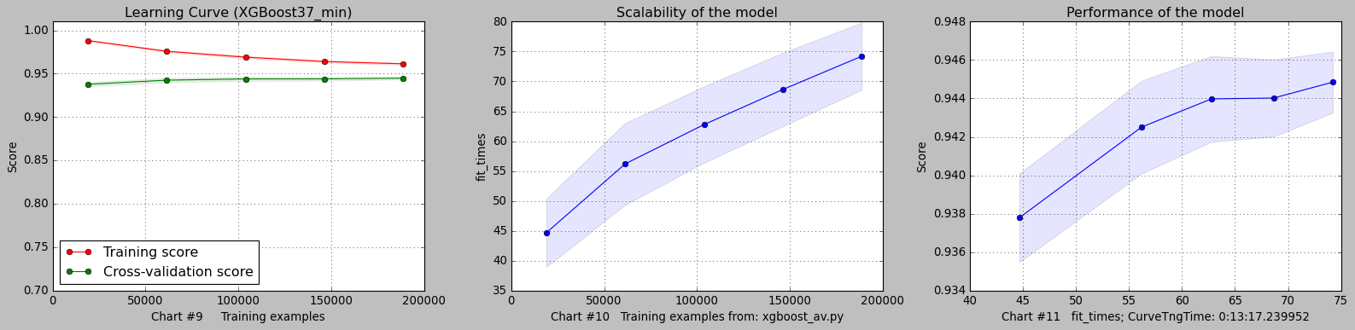
Exploring Model Performance v3 (EMP)

Slide 18
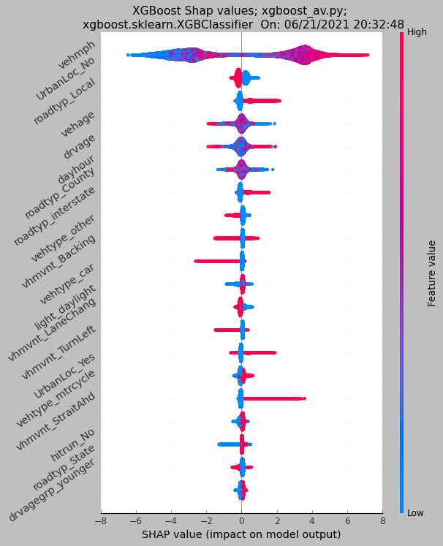
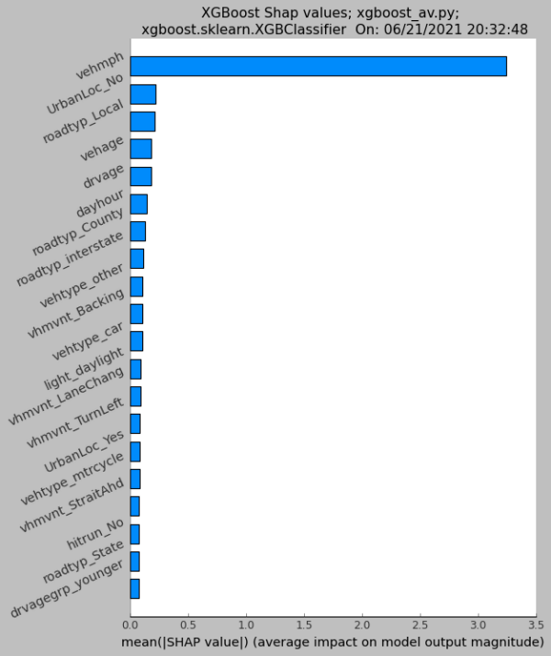
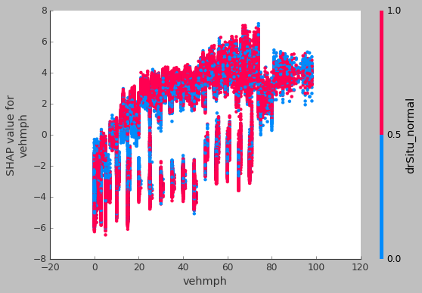
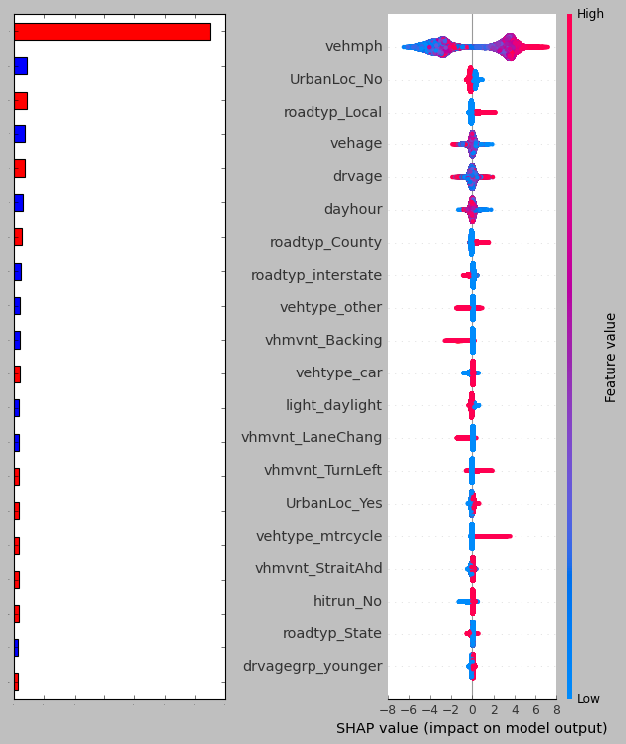
Explaining the Model v2

Slide 19
Let’s see some code!!
*Disclaimer…

Slide 20
I could only have done this by the wonderful gifting of the Lord, Jesus. Know Him, know peace. ☺
Steve Schneider
SteveS@SQLinsight.net
linkedin.com/in/steveschneider1
https://github.com/steveSchneider2/Pass

